Slide 1
Introduction to GDPR and data protection
How to legally process and protect personal data in real life

Slide 2
Introduction
Agenda
Introduction to data protection and GDPR
GDPR: Overview and most important Articles
Key terms and concepts around the processing of personal data
Principles of data processing
Lawfulness of data processing and conditions for consent
Controller, processor and joint controllers
Special categories of personal data
Data protection impact assessment
Introduction to the EOSC Future DPMS
What is a DPMS?
Guidance & Templates
Responsibilities of EOSC Future partners

Slide 3
Introduction to data protection and GDPR

Slide 4
Personal data
Data protection according to the General Data Protection Regulation (GDPR – the European Data Protection Act) is about the protection of personal data, such as …
name, address, telephone number, e-mail address, bank details, car registration number, customer number, personnel number, purchase/payment transactions, website usage data, location, transaction data, performance evaluations, visit data, information on hobbies, age, sex, nationality, skin colour, eye colour, health data, family status, religious affiliation, household size, sexual orientation, curriculum vitae, ...

Slide 5
Processing of personal data
Processing of personal data means any form of collection, recording or use of such data.
It does not matter whether the processing is done electronically (IT-supported) or manually (e.g. on paper).
The person whose data is processed is referred to as the data subject.
A legal entity (company, organization) that processes personal data of data subjects is called a controller (for data processing).

Slide 6
Processing of personal data
Basic case:
Involvement of third party data processors:

Slide 7
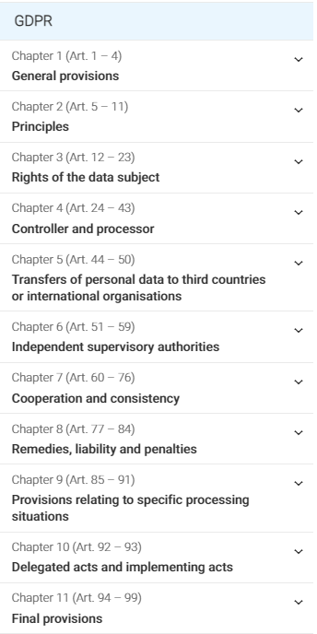
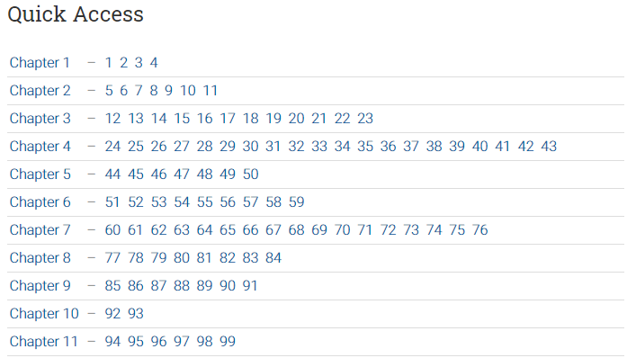
The GDPR
Recommended website (free and easy to navigate):
https://gdpr-info.eu/

Slide 8
GDPR: Most important Articles
Article | Content
Art. 4 | Definitions
Art. 5 | Principles
Art. 6 | Lawfulness of processing
Art. 7 | Conditions for consent
Art. 12-22 | Rights of the data subject (excerpt)
Art. 25 | Data protection by design / default
Art. 26 | Joint controllers
Art. 28-29 | Processors
Art. 30 | Records of processing activities
Art. 32 | Security of processing
Art. 33-34 | Notification of a personal data breach
Art. 35 | Data protection impact assessment

Slide 9
Principles of data processing (Art. 5 GDPR)
Personal data shall be …
processed lawfully and in a way that is transparent to the data subject;
be processed for specified and legitimate purposes and not processed in a way incompatible with those purposes;
adequate and relevant to the purposes and limited to what is necessary for the purposes (“data minimization”);
accurate and, where necessary, kept up to date;
kept in a form which permits identification of data subjects for no longer than necessary for the purposes (“storage limitation”);
processed in a manner that ensures appropriate security of personal data, including protection against unauthorized or unlawful processing and against loss (integrity and confidentiality).

Slide 10
Principles of data processing (Art. 5 GDPR)
Summary
Lawfulness
Integrity and confidentiality
Specified purpose
Storage limitation
Data minimization
Accuracy

Slide 11
Principles of data processing (Art. 5 GDPR)
Example
To register for a conference, the following information need to be provided in the online registration form:
Last name
First name
Date of birth
Nationality
E-mail address
Mobile phone
Education degree
Company
Organisation type
Last conference you attended
Allergies / dietary requirements
What is the purpose of data processing?
Which principle according to Art. 5 GDPR is violated?

Slide 12
Principles of data processing (Art. 5 GDPR)
Example
To register for a conference, the following information need to be provided in the online registration form:
Last name
First name
Date of birth
Nationality
E-mail address
Mobile phone
Education degree
Company
Organisation type
Last conference you attended
Allergies / dietary requirements
What is the purpose of data processing?
To manage conference attendance, plan/organise the conference and related sessions, plan/provide catering, and communicate with conference participants in matters related to conference
Which principle according to Art. 5 GDPR is violated?

Slide 13
Principles of data processing (Art. 5 GDPR)
Example
To register for a conference, the following information need to be provided in the online registration form:
Last name
First name
Date of birth
Nationality
E-mail address
Mobile phone
Education degree
Company
Organisation type
Last conference you attended
Allergies / dietary requirements
What is the purpose of data processing?
To manage conference attendance, plan/organise the conference and related sessions, plan/provide catering, and communicate with conference participants in matters related to conference
Which principle according to Art. 5 GDPR is violated?
Data minimisation

Slide 14
Lawfulness of data processing (Art. 6 GDPR)
According to GDPR, personal data may be processed by a data controller under any one of the following conditions:
The data subject has given the data controller his/her voluntary consent to the processing for the intended purpose.
The processing is necessary for the performance (or initiation) of a contract between the controller and the data subject.
The processing is necessary for the fulfilment of a legal obligation on the part of the data controller.
The processing is necessary to protect vital interests.
The processing is necessary for the performance of a task carried out in the public interest on behalf of the data controller.
The processing is necessary in order to protect the legitimate interests of the data controller or of a third party, except where such interests are overridden by the interests of the data subject.

Slide 15
Lawfulness of data processing (Art. 6 GDPR)
Summary
Consent
Contract with the data subject
Legal obligation
Protection of vital interests
Public interest
Legitimate interest

Slide 16
Lawfulness of data processing (Art. 6 GDPR)
Example
What is (most likely) the legal basis for the following processing activities?
Participant registration for a conference
Subscription for a newsletter
Monitoring / tracking of user activities on a website
Timekeeping of employees’ working times
Video surveillance / recording in a company’s headquarter building

Slide 17
Lawfulness of data processing (Art. 6 GDPR)
Example
What is (most likely) the legal basis for the following processing activities?
Participant registration for a conference
Entering in a contract with the data subject
Subscription for a newsletter
Consent from the data subject
Monitoring / tracking of user activities on a website
🡪 For performance / security purposes: Legitimate interest of the controller
🡪 To enhance the user experience: Consent from the data subject
Timekeeping of employees’ working times
Contract or legal obligation or legitimate interest
Video surveillance / recording in a company’s headquarter building
Legitimate interest of the controller

Slide 18
Conditions for consent (Art. 7 GDPR)
Freely given *)
Traceable **)
Request for consent presented in clear and plain language
Right to withdraw at any time
As easy to withdraw as to give consent
*) e.g. no pressure on the data subject, no “disadvantages” if not giving consent
**) The controller shall be able to demonstrate that the data subject has consented to processing of his or her personal data.

Slide 19
Rights of the data subject (Art. 12-22 GDPR)
Transparent information
Right of access
Right of rectification
Right to erasure
Right to restriction of processing
Right to data portability
Right to object to processing
Right to not be subject to automated decision making and profiling

Slide 20
Data protection by design and by default (Art. 25 GDPR)
By design:
Implement appropriate technical and organisational measures
Integrate the necessary safeguards into the processing in order to meet GDPR requirements and protect the rights of data subjects
By default: Ensure through technical and organizational measures that only personal data which are necessary for the specific purpose are processed – with respect to …
the amount of personal data collected
the extent of their processing
the period of their storage
their accessibility

Slide 21
Data protection by design and by default
Example
You are a developer of HR management software. How do you implement data protection …
by design?
by default?

Slide 22
Data protection by design and by default
Example
You are a developer of HR management software. How do you implement data protection …
by design?
by default?
Support state of the art encryption of personal data
Support state of the art access control with multi factor authentication
Pseudonymisation and anonymisation options for reports generated from the tool
Option to limit / restrict data access and export (depending on the role of the user)
Option to set a retention / deletion policy for a given data set
…
By default, activate encryption and multi factor authentication
By default, activate automated deletion of recruiting data after 6 months
…

Slide 23
Joint controllers (Art. 26 GDPR)
Joint controllership = two or more controllers jointly determine the purposes and means of processing
Key requirement for joint controllers: Determine their respective responsibilities for GDPR compliance in a transparent manner, in particular as regards the exercising of the rights of the data subject
🡪 joint controller agreement (JCA) between the controllers
Data subjects may exercise their rights against each of the controllers.

Slide 24
Processors (Art. 28-29 GDPR)
Controllers shall use only processors providing sufficient guarantees to implement appropriate technical and organisational measures to meet GDPR requirements.
Processors shall not engage other processors without prior specific or general authorisation of the controller.
Processing by a processor shall be governed by a contract
🡪 data processing agreement (DPA) between the controller and processor

Slide 25
Records of processing activities (Art. 30 GDPR)
Each controller must maintain records of processing activities under their responsibility, covering at least:
Name and contact details of the controller
Purposes of the processing
Categories of personal data
Categories of data subjects (from which personal data are processed)
Categories of recipients to whom the personal are disclosed
Transfers of personal data to a third country
Time limits for erasure of the different categories of data
Description of the technical and organisational security measures taken
Processors must also maintain records of their processing activities performed on behalf of a controller (comparable requirements).

Slide 26
Data protection impact assessment (Art. 35 GDPR)
Goal of a data protection impact assessment (DPIA)
Assess and understand the impact of envisaged processing operations on the protection of personal data
Prevent data processing that would result in unacceptable risks to the rights and freedoms of natural persons
When must a DPIA be carried out?
In general: Whenever data processing is likely to result in a high risk to the rights and freedoms of the data subjects
In particular in the case of:
systematic and extensive evaluation of personal aspects which is based on automated processing, including profiling, and on which decisions are based that produce legal effects concerning the natural person
processing on a large scale of special categories of data
systematic monitoring of a publicly accessible area on a large scale

Slide 27
Special categories of personal data (Art. 9 GDPR)
Special categories are defined as:
Any data revealing …
racial or ethnic origin
political opinion
religious or philosophical beliefs
trade union membership
Genetic data
Biometric data (for the purpose of uniquely identifying a natural person)
Data concerning health
Data concerning a natural person’s sex life or sexual orientation
The processing of these categories of personal data is bound to special prerequisites.

Slide 28
Introduction to the EOSC DPMS

Slide 29
What is a DPMS?
A data protection management system (DPMS) is the entirety of policies, processes, procedures, responsibilities and tools to effectively manage the lawful processing of personal data and achieving compliance with GDPR, including:
A data protection policy
Topic-specific policies related to data protection
Records of processing activities
Records of joint controller agreements and data processing agreements
Records of data protection impact assessments
Plans and records of data protection awareness activities
Processes / procedures for handling requests from data subjects, maintaining the records of processing agreements, conducting data protection impact assessments, and any other relevant processes and procedures
…

Slide 30
EOSC DPMS: Main goals
Create a solid level of awareness and promote exchange on data protection and GDRP among EOSC partners and their representatives
Provide clear and pragmatic guidance and support to those responsible for activities involving the processing of personal data
Create transparency of all data processing activities in the scope of EOSC
🡪 Overall, we aim at enabling every EOSC partner to achieve GDPR compliance w.r.t. the EOSC activities being carried out by that partner.

Slide 31
The EOSC Data Protection Policy
Defines requirements that must be complied with whenever personal data are processed in the context of EOSC Future / the EOSC portal
Can be found here: https://wiki.eoscfuture.eu/x/yYI8AQ
Topics addressed:
Personal data
Principles
Processing of personal data
Data subjects’ rights
Data protection management in EOSC

Slide 32
EOSC DPMS: Guidance and templates
Guidance & Support:
I would like to set up a survey that includes questions related to personal data. Following the survey, I want to evaluate the answers and create / distribute a report.
I would like to organise and hold a training of webinar. Following the training / webinar, I may want to get or stay in touch with the participants.
Templates:
Data privacy statement (Template)
Data processing agreement (Template)
Data protection impact assessment (Template)
Joint controller agreement (Template)
Subcontractor agreement (Template)

Slide 33
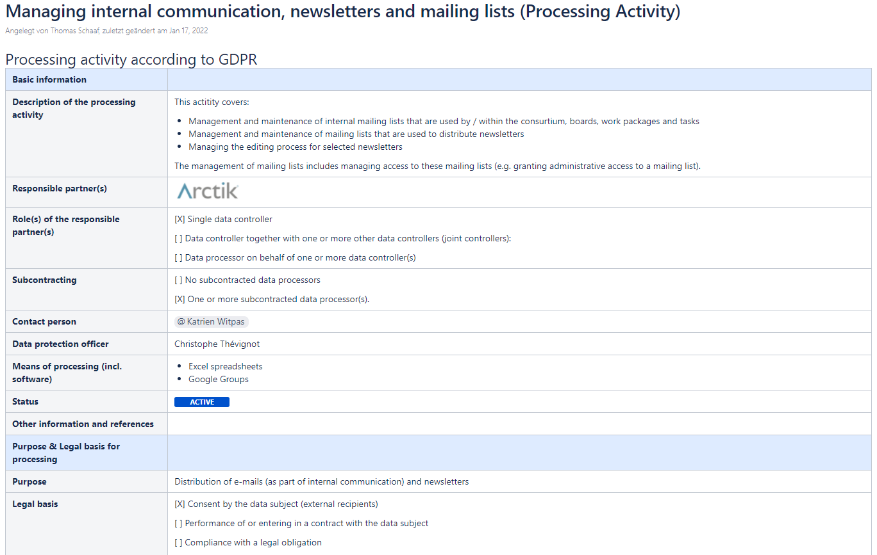
Transparency over data processing activities
Online inventory of all processing activities (Confluence)
Easy process to submit / report a new processing activity in the scope of EOSC

Slide 34
Fleur Lebhardt
EOSC Data Protection Coordinator
fleur.lebhardt@technopolis-group.com
Thomas Schaaf
Consultant
thomas.schaaf@t-online.de

