Slide 1
T8.2 EOSC DIH
Elisa Cauhe (EGI Foundation)
Prague, November 2022

Slide 2
The Context
“
…EOSC extends to the public and private sector, and to society at large.
- Preface by Karel Luyben, EOSC Executive Board Chair (2019-2020), EOSC Association President

Slide 3
The Context Continued
“
EOSC Action Area: Widening to public and private sectors and going global
“
EOSC must demonstrate value and impact that is relevant and meaningful to the diverse groups belonging to the broader public sector and to the private sector
“
The scope of EOSC is widened to serve the public and private sectors

Slide 4
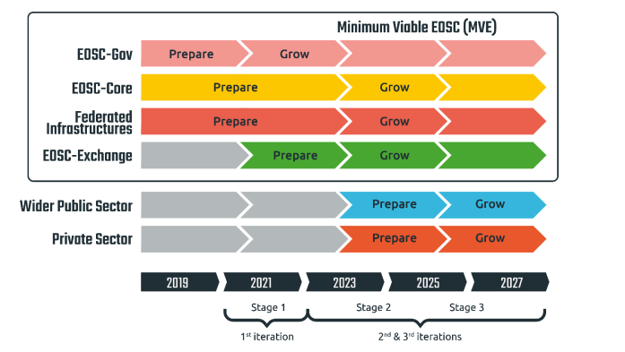
EOSC Timeline
EOSC Future WP8 and the EOSC DIH are actions that support stage 2 of the Widening implementation action

Slide 5
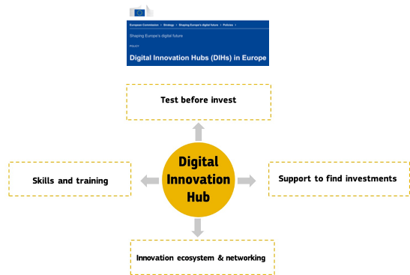
EOSC DIH
What is DIH?
EC Definition: “One-stop shops that help companies dynamically respond to the digital challenges and become more competitive”
What is the EOSC DIH?
A DIH that aims to stimulate joint innovation with private enterprises by leveraging EOSC services, data and expertise
Main Objective
Serve as an industrial engagement channel for other EC projects and initiatives for engaging with the EOSC
Target Groups
Spin-offs; Start-ups; SMEs
EOSC support/regional projects
Multiplier networks
Other DIHs/EDIHs

Slide 6
EOSC DIH Mission and Vision
MISSION
VISION
Enabling the private sector to make use of EOSC resources greatly increases the potential for innovation and economic impact of EOSC
EOSC DIH supports the private sector to become major user group of EOSC

Slide 7
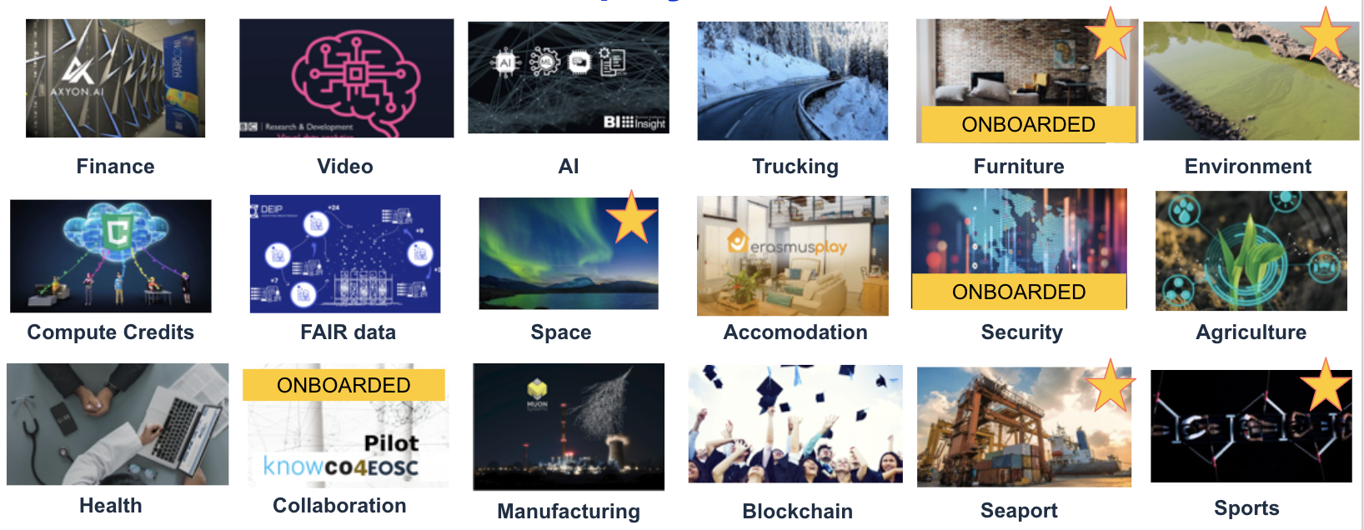
EOSC DIH – Creation to Expansion
Creation
Expansion
Business pilots (as partners and in kind support)

Slide 8
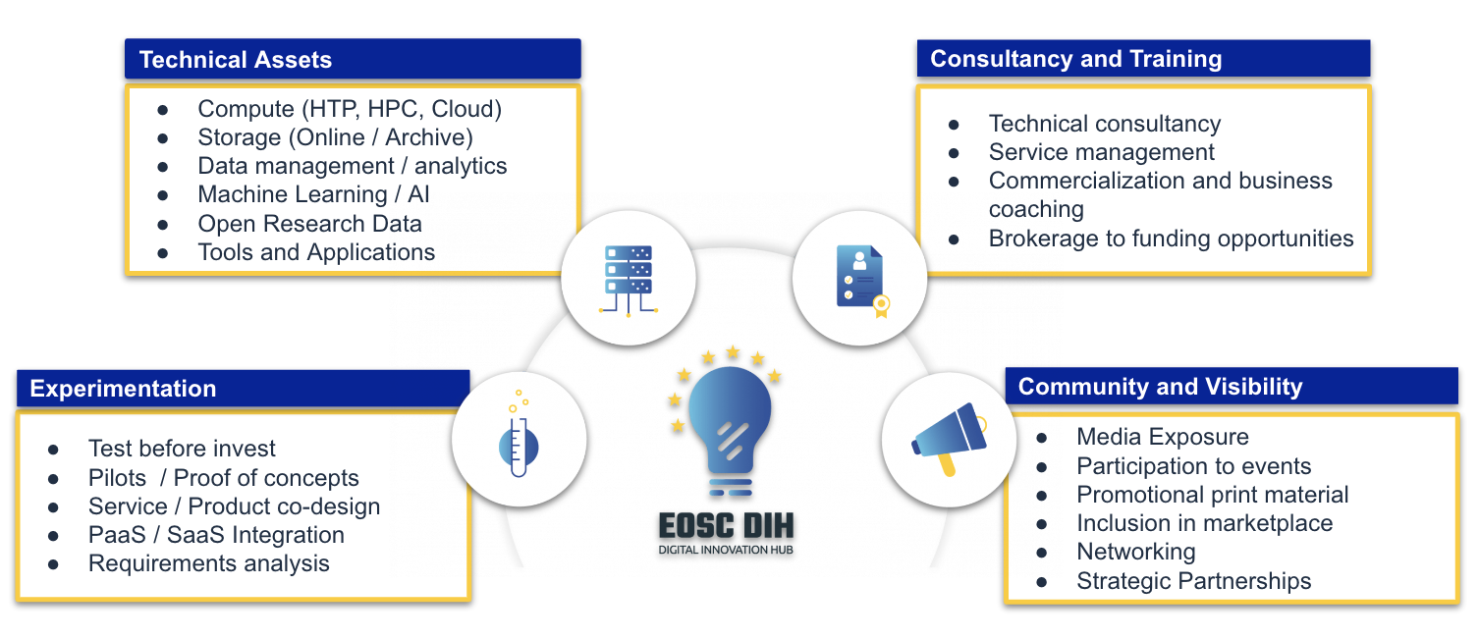
EOSC DIH Services + EOSC Project Services

Slide 9
The matchmaking
Technical requirements
EOSC services and Technical Support
Business oriented service catalogue
Pilot campaigns Consultancy
SLAs
Shepherd role
Success stories and visibility
Impact assessment
Support on EOSC onboarding

Slide 10
Value: Enriching and Exploiting the EOSC
Exploiting the EOSC
SMEs using services from the EOSC
SMEs bringing services / data to the EOSC
Enriching the EOSC

Slide 11
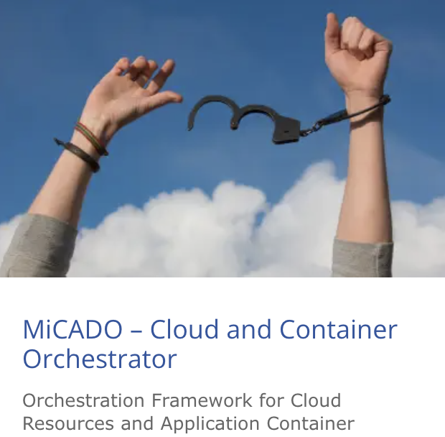
Pilots brought by the community

Slide 12
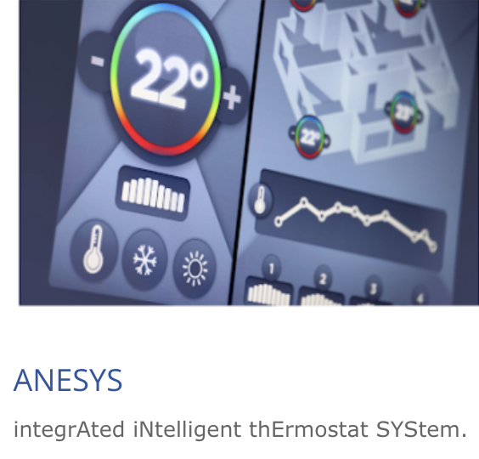
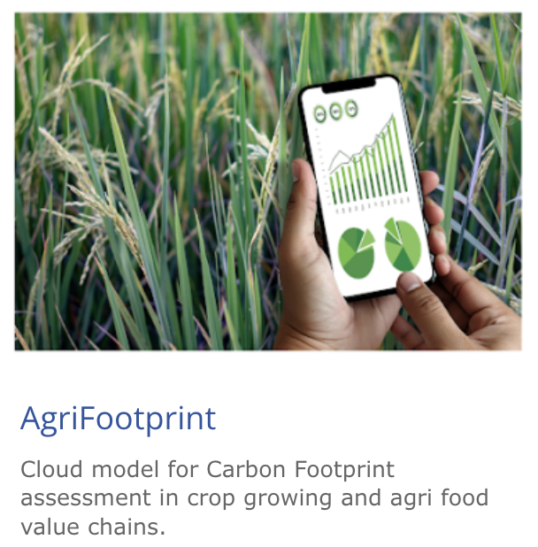
Pilot from 1st pilot campaign (2021)

Slide 13
Pilots from 2nd pilot campaign (2022)
GTO HPC
IRAZ
LONGTERMDATA
PREMACOOL
REGREEN
SOFIA
YDMS
UDOS
TWC SCUP

Slide 14
EOSC DIH Expression of Interest for Business Pilots: 4th Round
Deadline
15th December
Webinar coming soon
Stay tuned!

Slide 15
EOSC DIH Monitoring & Evaluation Framework
Policy context analysis
Interviews with other DIHs
EOSC DIH Intervention Logic
EOSC DIH M&E Framework
Interviews with other DIHs
Periodic monitoring
Interviews with Pilots
Digital maturity Questionnaire

Slide 16
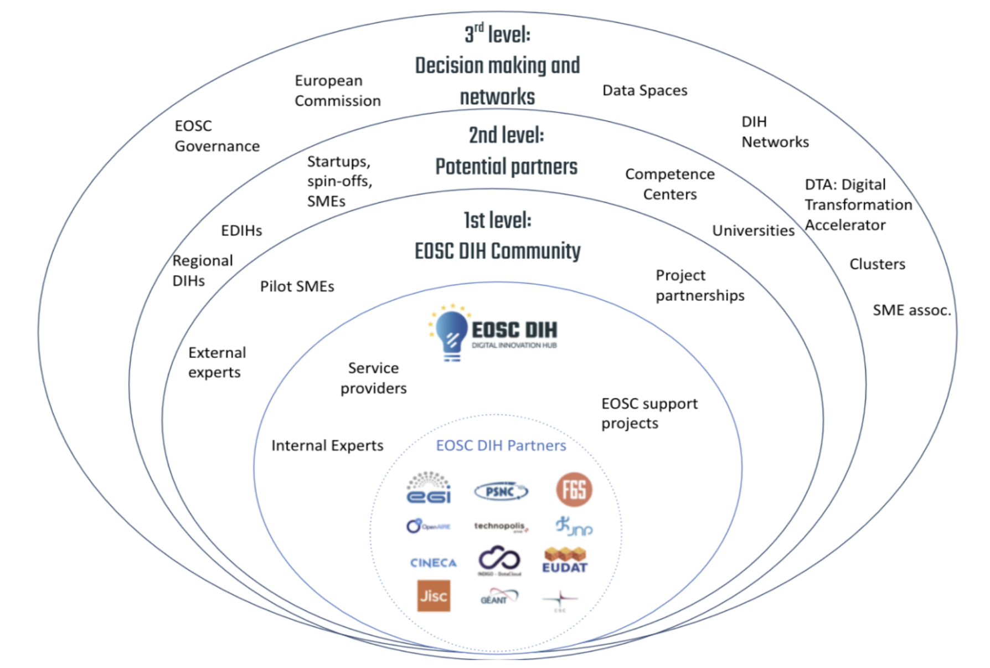
EOSC Community

Slide 17
Expansion and Operation in EOSC Future
Collaborations for service portfolio
INFRAEOSC-07 projects
Other projects
Partnerships with multipliers
Regional DIHs
Other DIH networks
Industry support initiatives
EOSC DIH is one of the EOSC Future Key Exploitable Results (also a KER in EOSC Hub project)

Slide 18
Companies in the Ecosystem

Slide 19
EOSC DIH in numbers
218
6
5
36
Informed SMEs
EOSC- projects collaborations
Regional DIH connected
Funding opportunities
43
6
18
17
SMEs supported
Onboarded services in the MP
Strategic partnerships
Industry events attended

Slide 20
How To Get Involved
Expression of Interest – co-creation
Attract wider community
Target specific areas
Join our community
Establish a partnership
Defining specific engagement areas
Contribute expertise in a specific field/area
Ask us through webpage
If you have a pilot idea
If you want to kick start engagement https://eosc-dih.eu/contact/
Collaboration with other projects
Being an exploitation channel for EOSC projects!!!!
Defining long-term collaboration scope and agreements https://eosc-dih.eu/partnerships/
Visit our booth!

